Slide 1

Chat Cneter Framework Based on NLP
Hazim Bukhari - 1740758
Ahmed AlMutairi - 1740898
Sultan AlFashkh - 1741406
Supervised by: Dr. Muhammed Dahab

Slide 2
Project Goal:
Develop framework that help organizations to improve their business.
Ease the process of retrieving data from databases.
answer Customers questions and serve them in short period of time and reduce operating costs.

Slide 3
Completed Objectives:
Allow the user to enter the query in the English language.
Convert user query to SQL.
Integrate with the SQL database.
Retrieve the appropriate answer from SQL database.
Formatting the answer.
Display the formatted answer to the user.

Slide 4
Draw Backs:
Capable of simple queries.
Need to name the with meaningful names.
Slow.

Slide 5
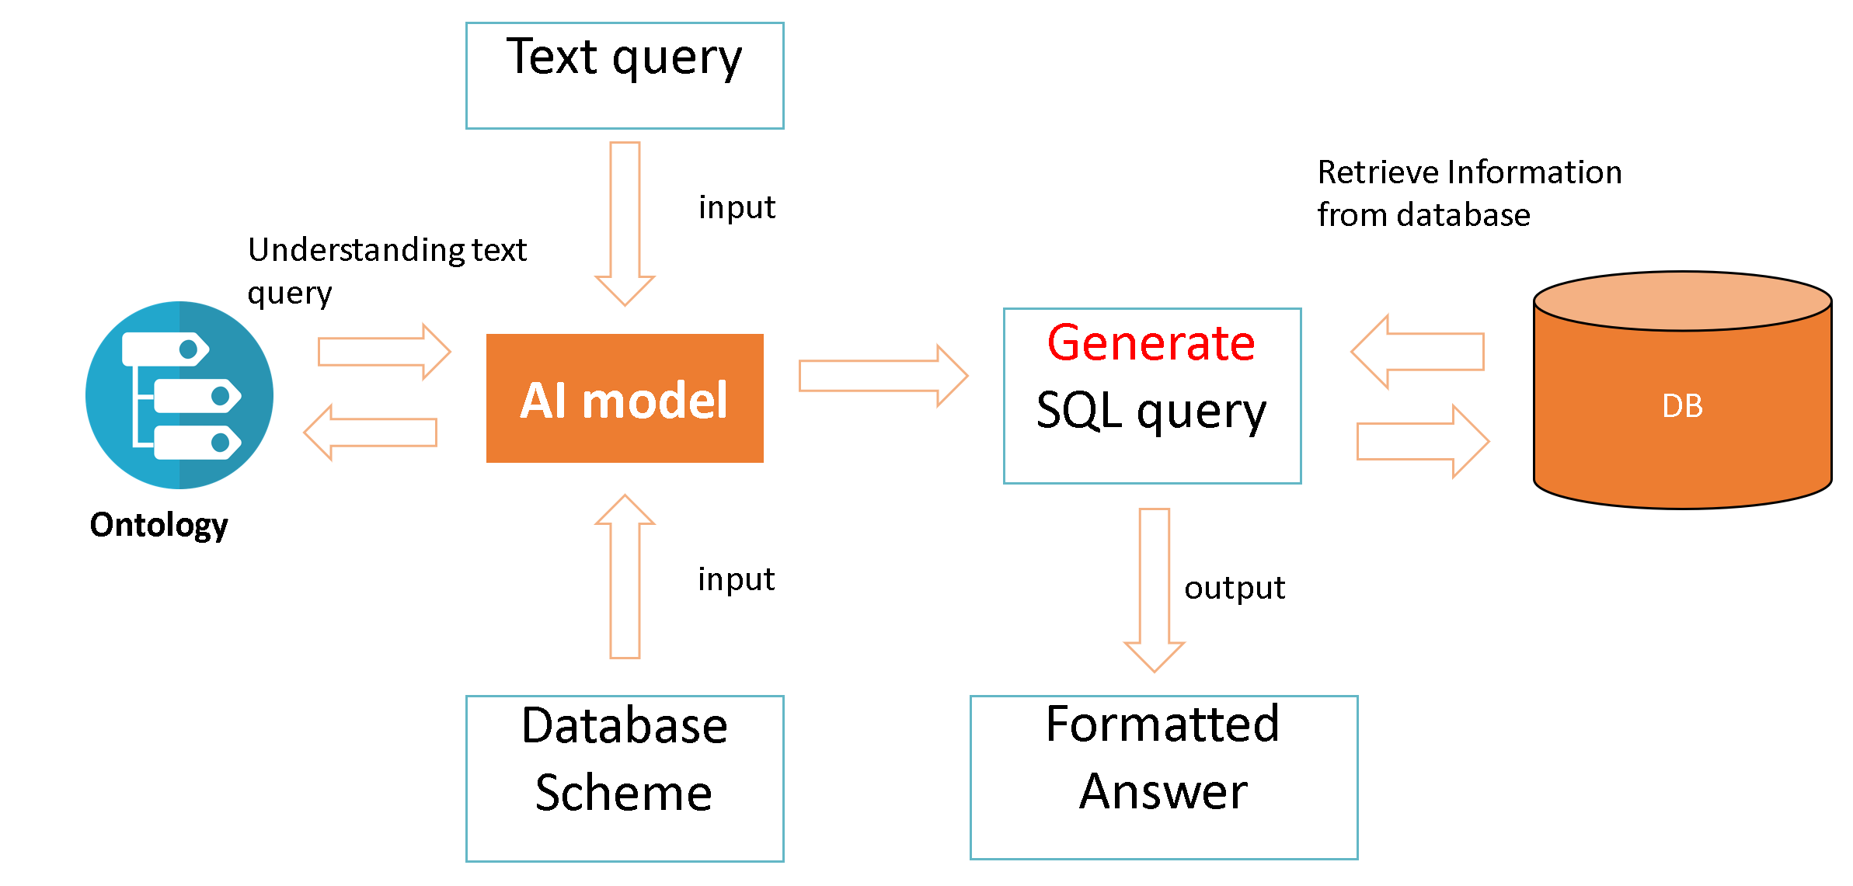
Framework Model:

Slide 6
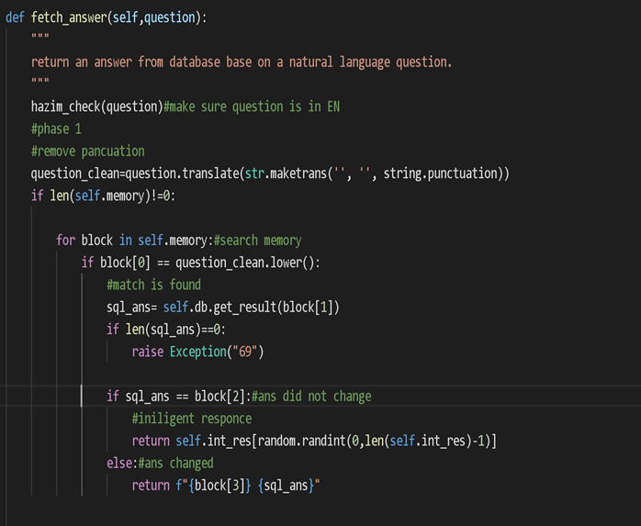
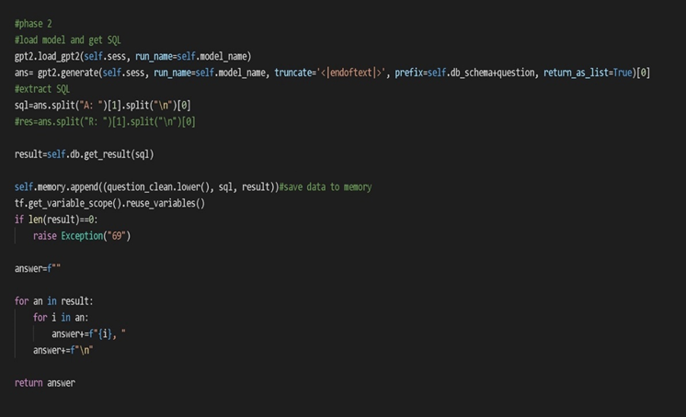
Back-end Code Snippet:

Slide 7
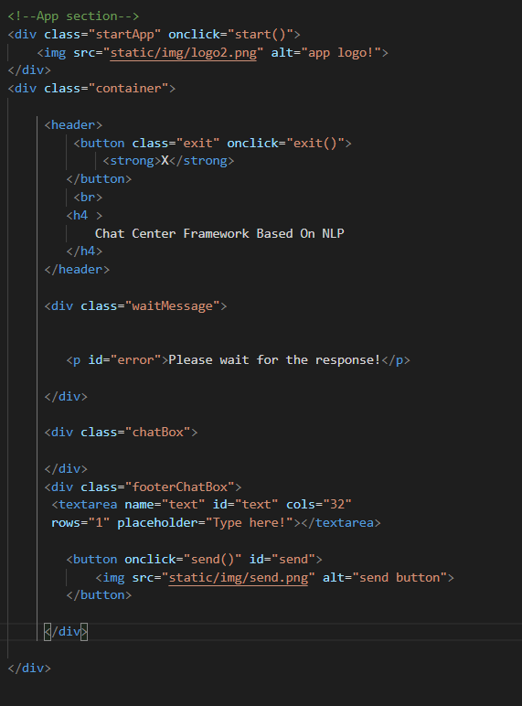
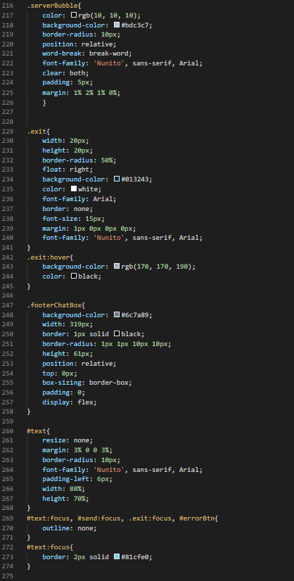
Front-end Code Snippet:

Slide 8
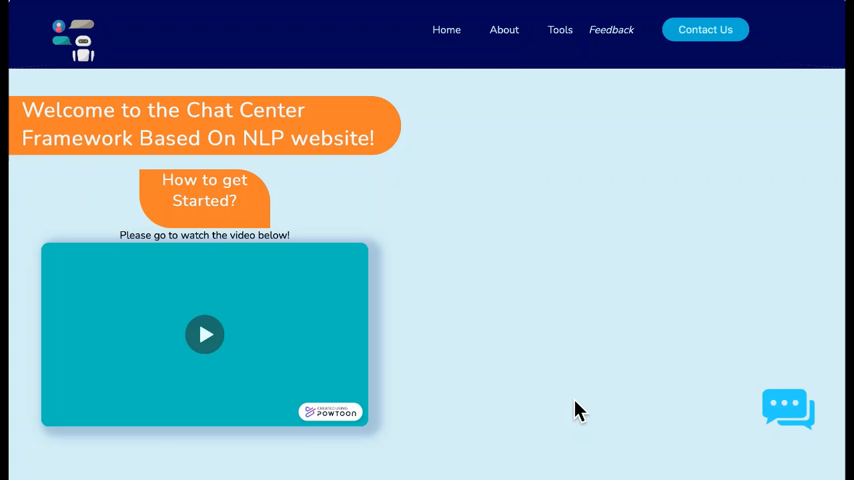
Demo:

Slide 9
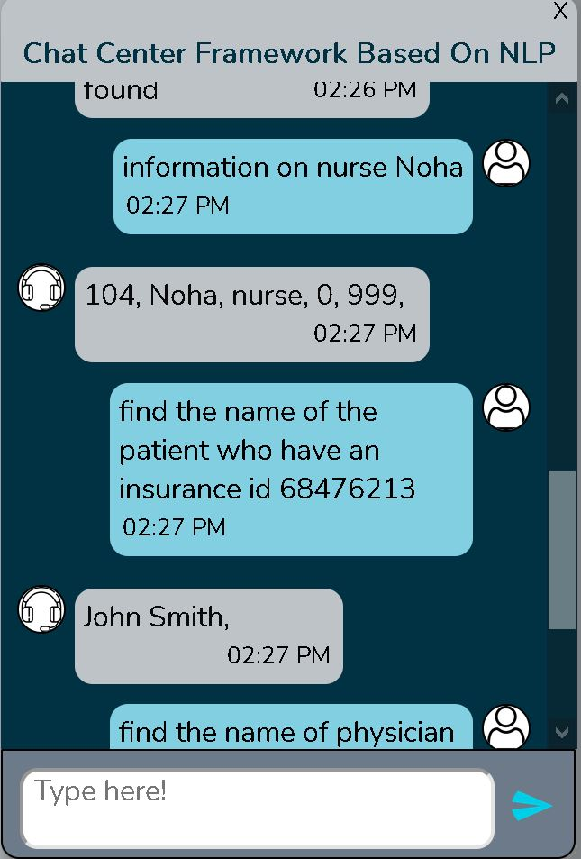
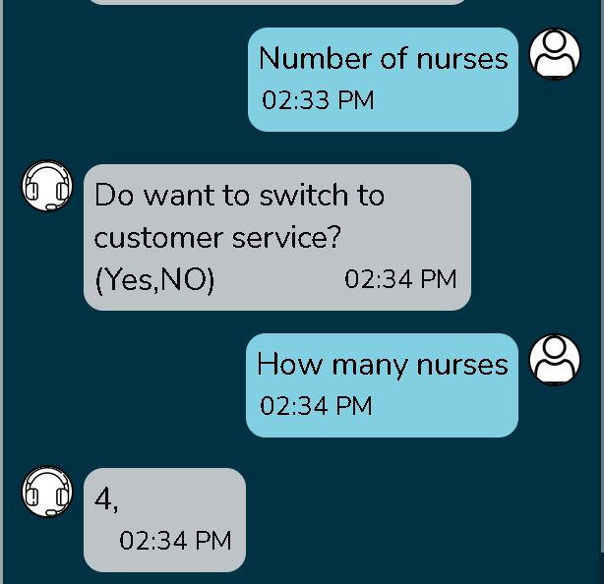
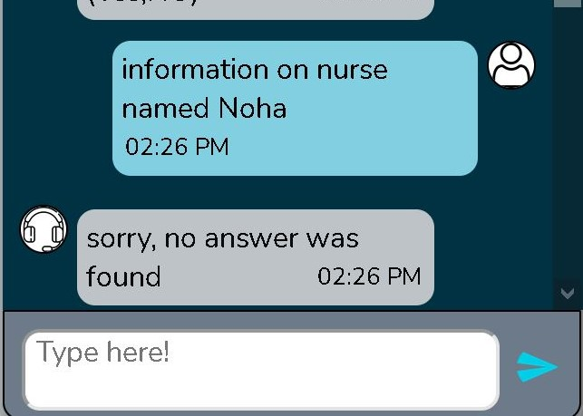
Evaluation:

Slide 10
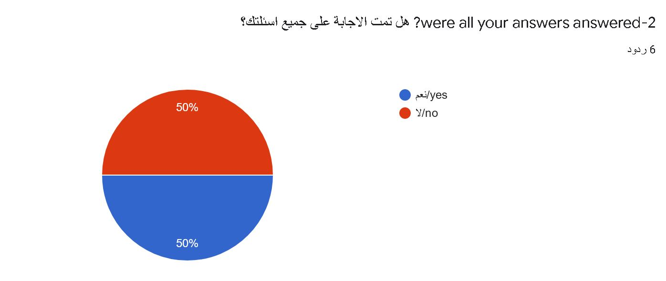
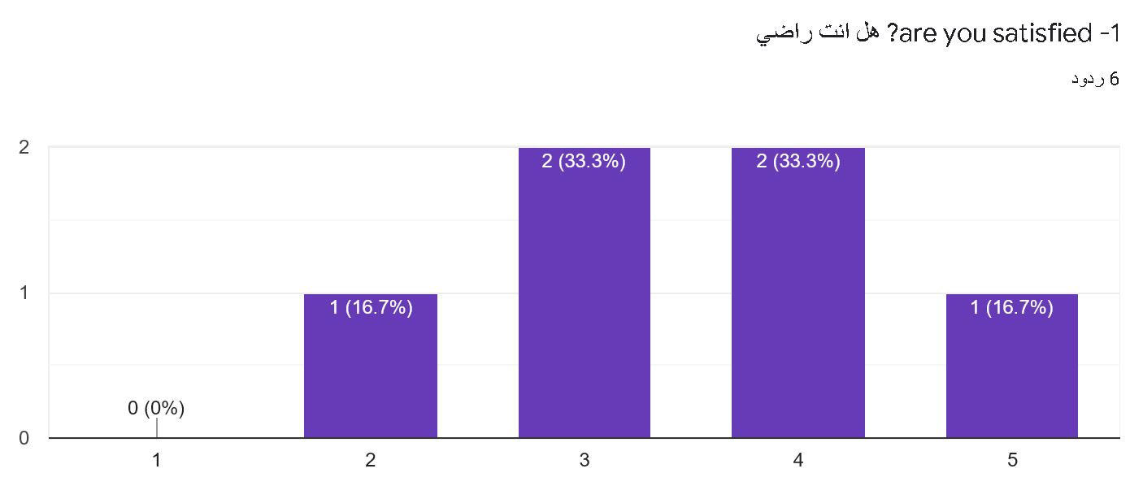
Customer Satisfaction:

Slide 11

Thank you for listening.

